Slide 1
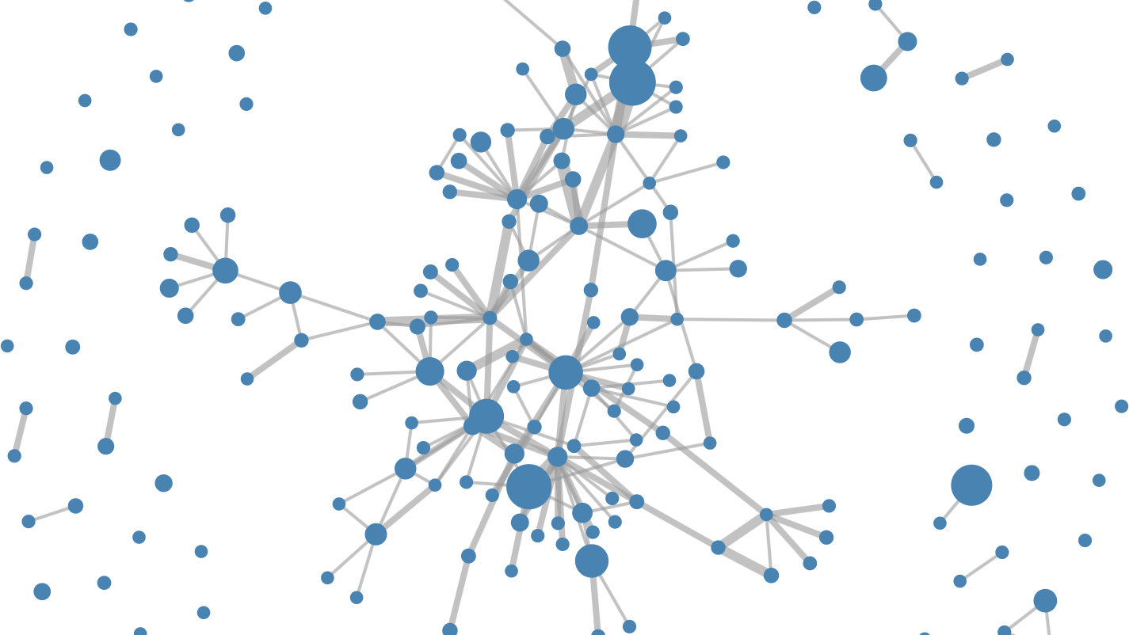
Connecting the dots: Machine Learning
for Vulnerability Discovery

Slide 2
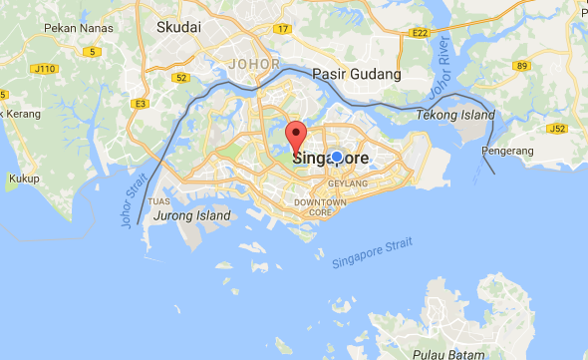
Asankhaya Sharma
https://www.sourceclear.com

Slide 3
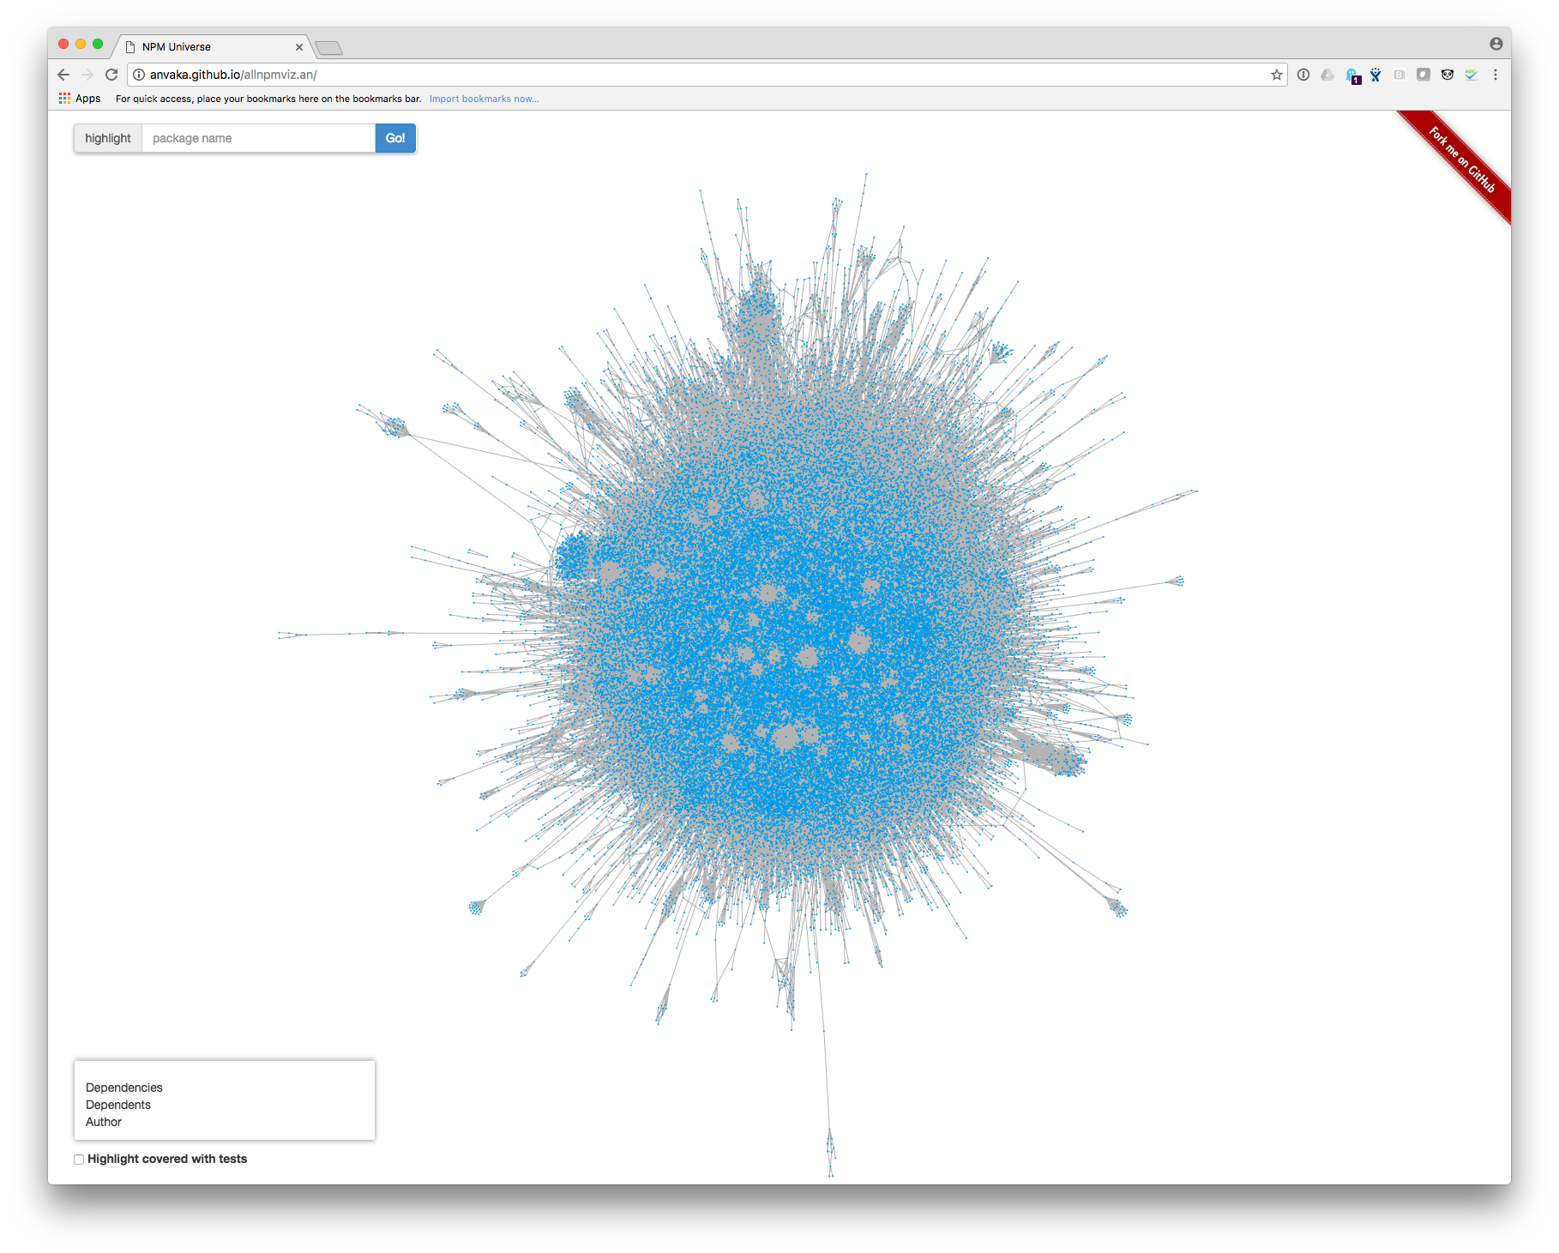
Control Over What is in Your Code Has Changed
From YOU to:
Developer Tools
Open-Source Code
3rd Party Developers
Reference : http://anvaka.github.io/allnpmviz.an/

Slide 4
Before Open-Source & DevOps
Open Source
Are you introducing vulnerabilities in the
code you are writing?
Custom Code

Slide 5
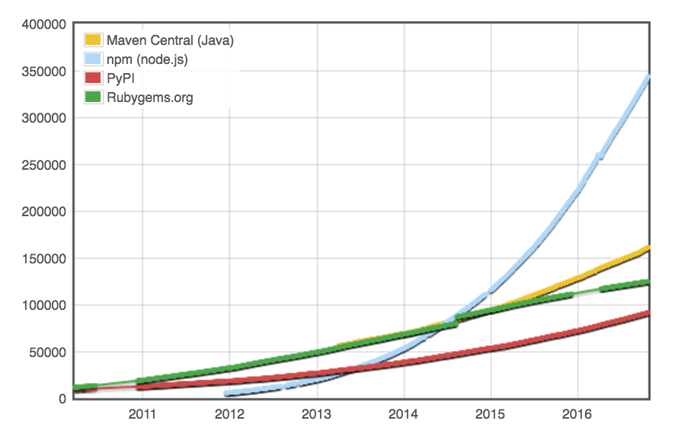
Open-Source Libraries Have Exploded
Reference : http://modulecounts.org

Slide 6
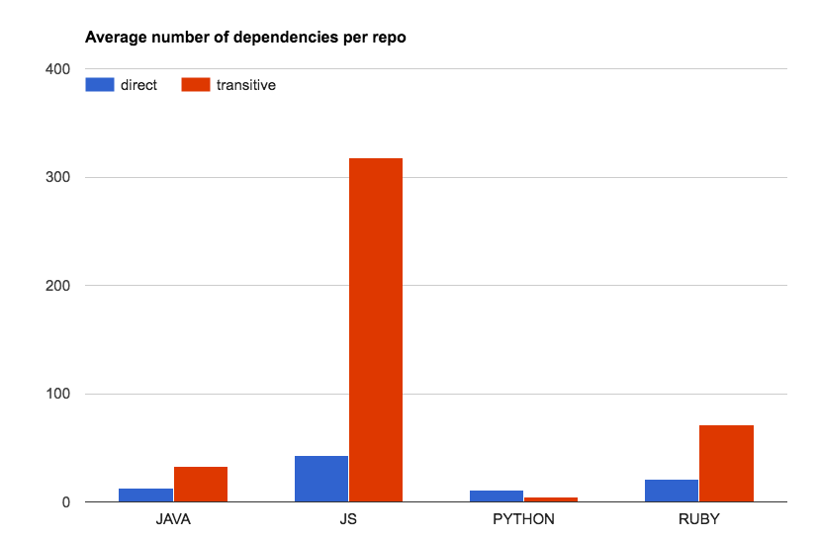
Complexity of Libraries Has Exploded
For every one library you add to a Node.js project, 9 others are added
For every 1 Java library you add to your projects, 4 others are added
Reference : SourceClear customer scans

Slide 7
After Open-Source /& DevOps
Custom Code
What libraries are you using?
Where did they come from?
What vulnerabilities are present?
Open Source
What does each library do?
Attack surface
has changed

Slide 8
Vulnerabilities in Open-Source
Known
CVEs / NVD
Advisories
Mailing list disclosures
Unidentified issues
New
Copy-paste
Inherited
Similar
Zero days

Slide 9
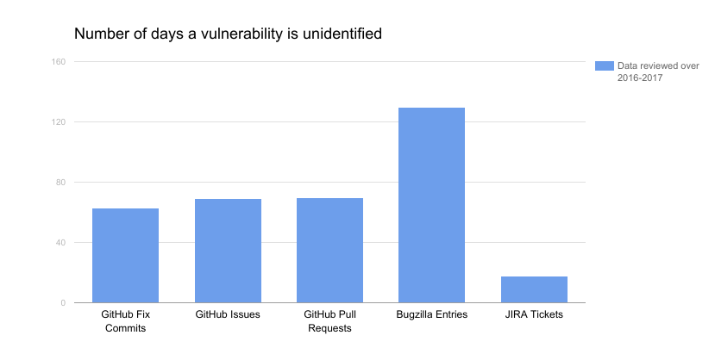
Mining for Unidentified Vulnerabilities

Slide 10
Workflow for Reviewing Unidentified Issues
Researcher
Vulnerability Knowledgebase
Workflow Engine
Queue
Machine Learning
Research Tool
REST API
Data Source
Bugzilla
Changelogs
NVD CVE
Commit Watcher
JIRA
GitHub
Misc.
Reserved CVE
Mailing List

Slide 11
Machine Learning for Identifying Vulnerabilities
“do machine learning like the great engineer you are, not like the great machine learning expert you aren’t.”
Martin Zinkevich, Rules of Machine Learning: Best Practices for ML Engineering http://martin.zinkevich.org/rules_of_ml/rules_of_ml.pdf

Slide 12
Smart Vulnerability Identification (SVI)
From commit messages

Slide 13
Process
SVI aims to help researchers to identify vulnerabilities faster in commitWatcher
Commit Messages
SVI
CommitWatcher
Input
Identify
Output

Slide 14
Input of SVI
SVI classifies the vulnerability by analyzing the commit messages
The commit messages are collected from GitHub commits
The commit messages are filtered by keywords in CommitWatcher
commit_id | commit_message (description of each commit)
1 | [tooltip] Fix #4779 (xss)
2 | Spelling: volnurable -> vulnerable
*~10% commits are related to vulnerabilities

Slide 15
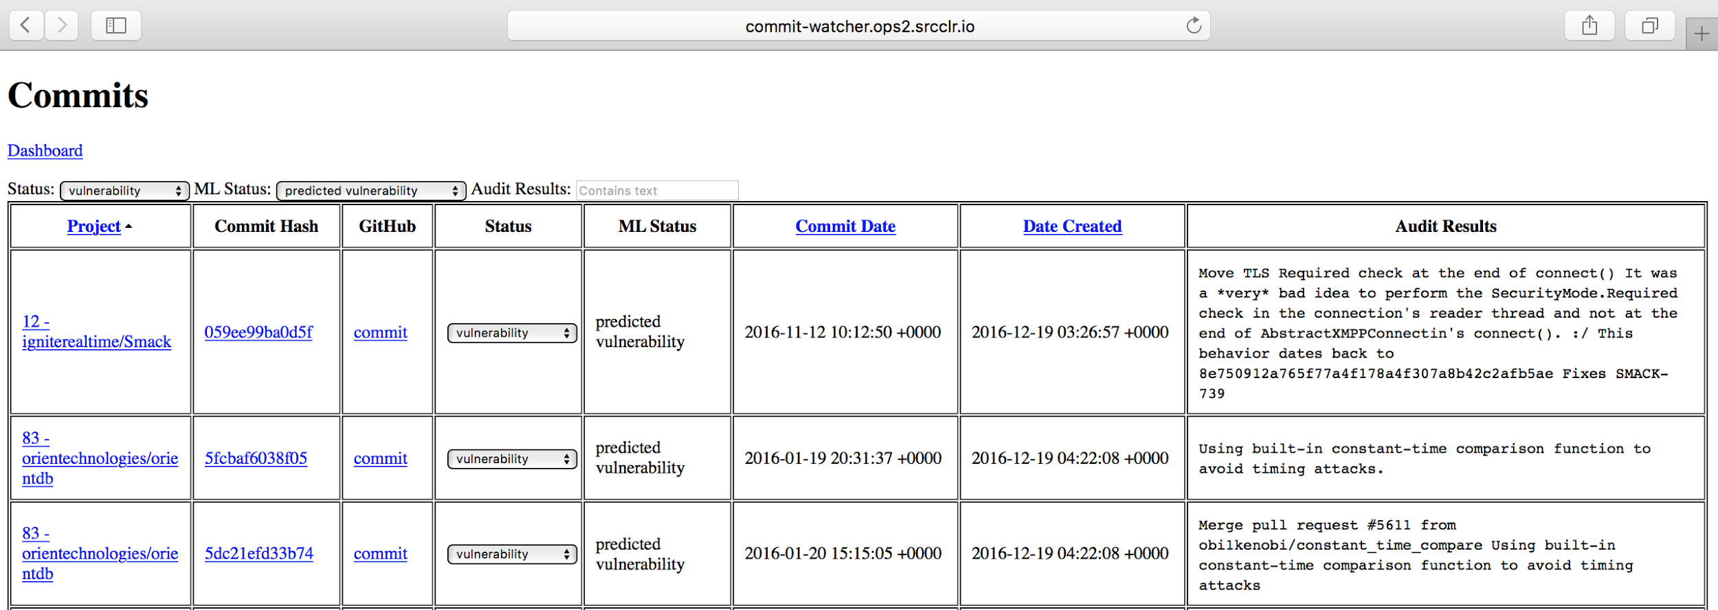
Output of SVI-Summarized results
Binary identification results shown in CommitWatcher

Slide 16
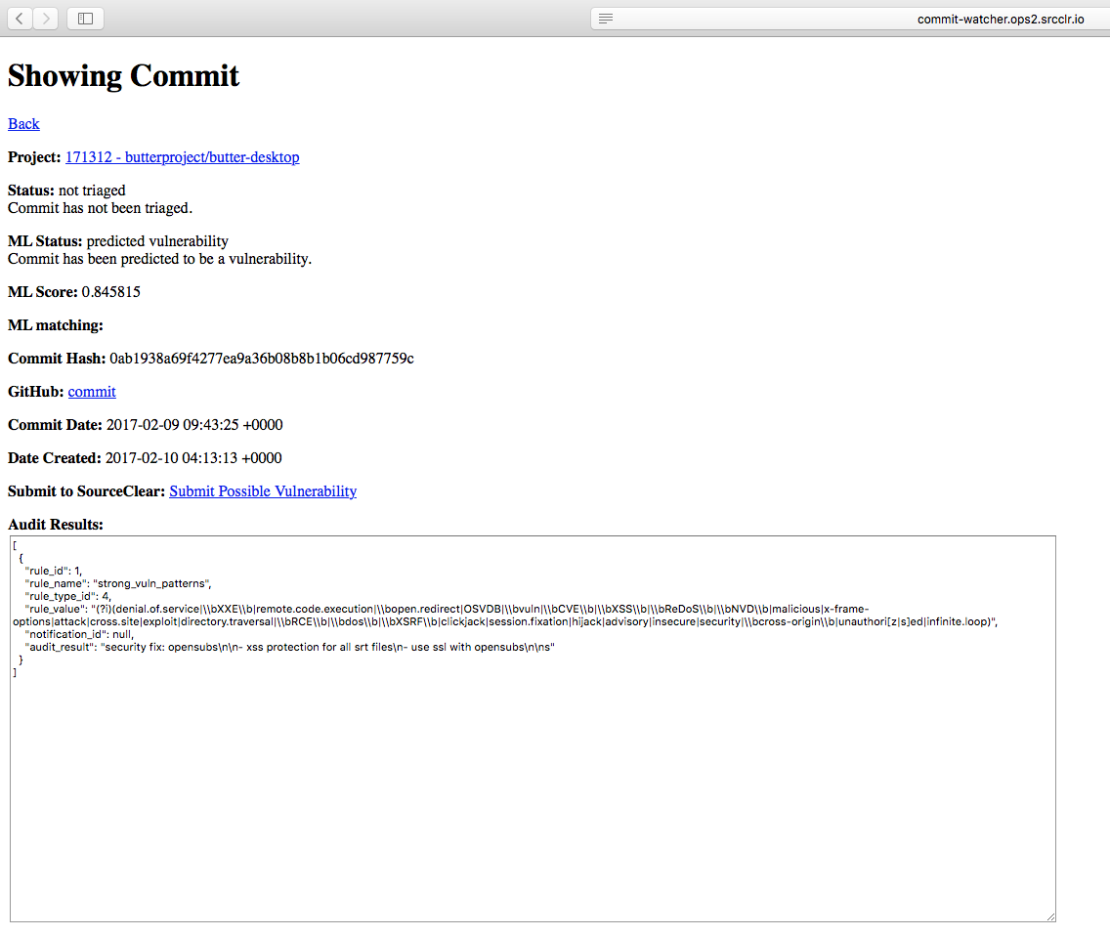
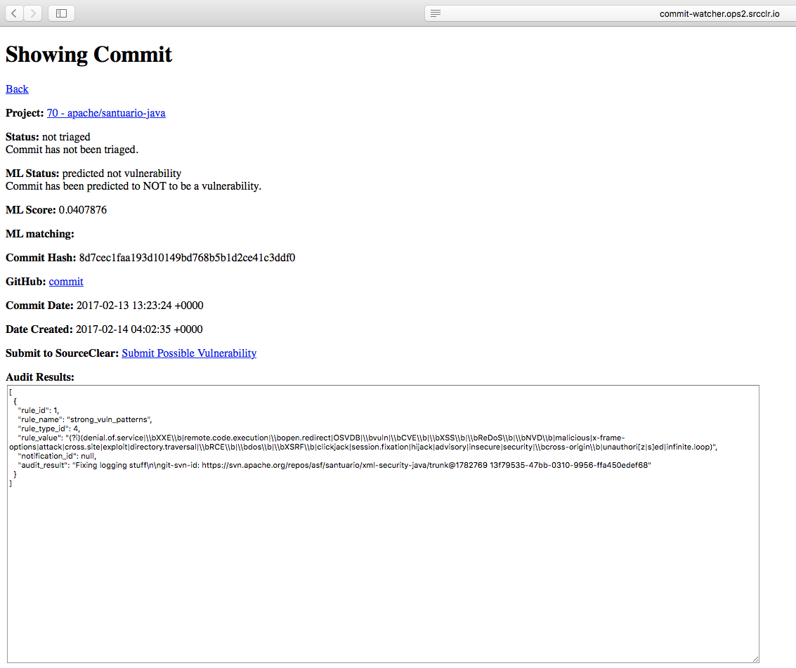
Output of SVI-Detailed analysis reports
Identified as vulnerability
Identified as non-vulnerability
Notes:
Change the picture later after getting ml matching

Slide 17
Training SVI

Slide 18
Understanding the dataset
Highly imbalanced
Around 1/10 commits are related to vulnerabilities after keywords filtering
Short, noisy texts
Most are few lines
Contain urls, directories, variable names...

Slide 19
First attempts
Against imbalanced dataset
Data centered approach
Undersampling over majority
Oversampling over minority
e.g., SMOTE (Synthetic Minority Oversampling TEchnique)
Model fitting approach
Cost-sensitive SVM
(Imbalanced) random forest
K-nearest neighbors
Naive-bayes...

Slide 20
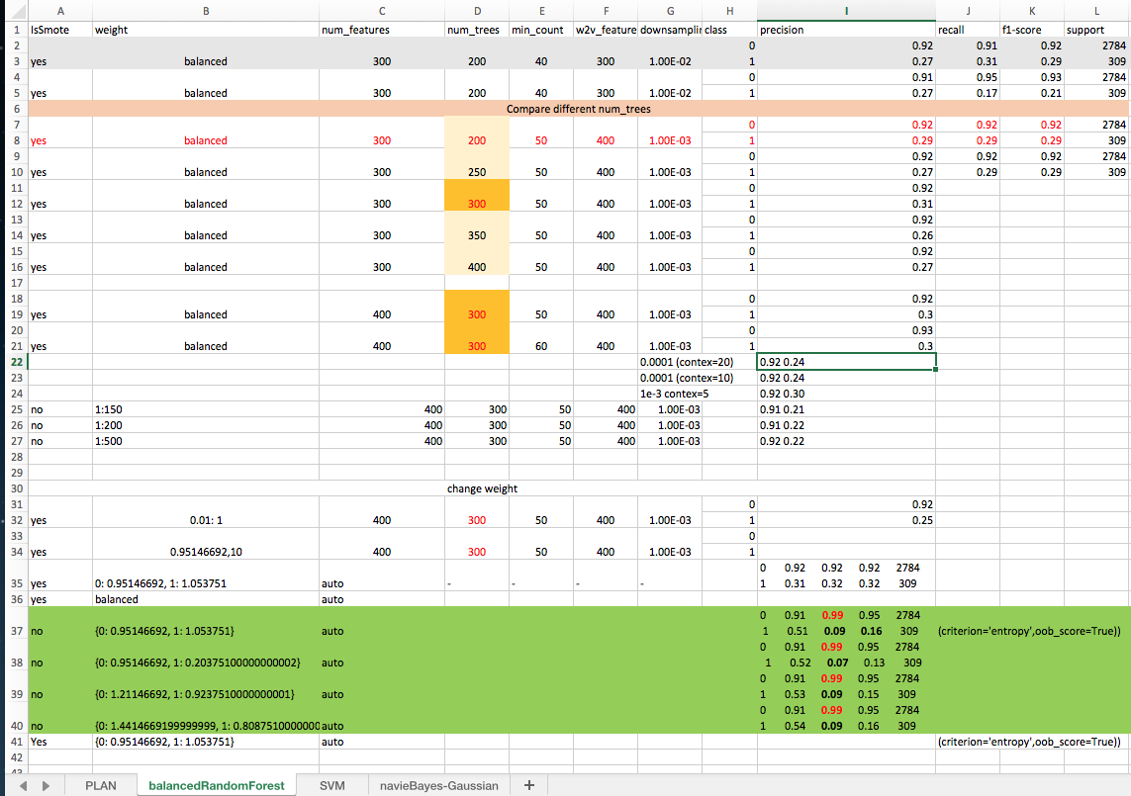
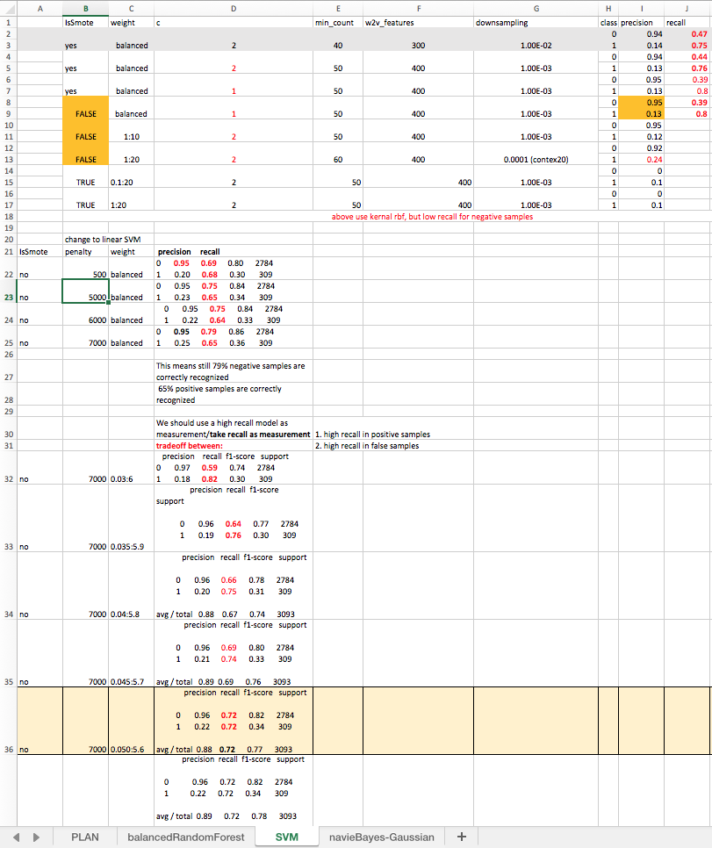
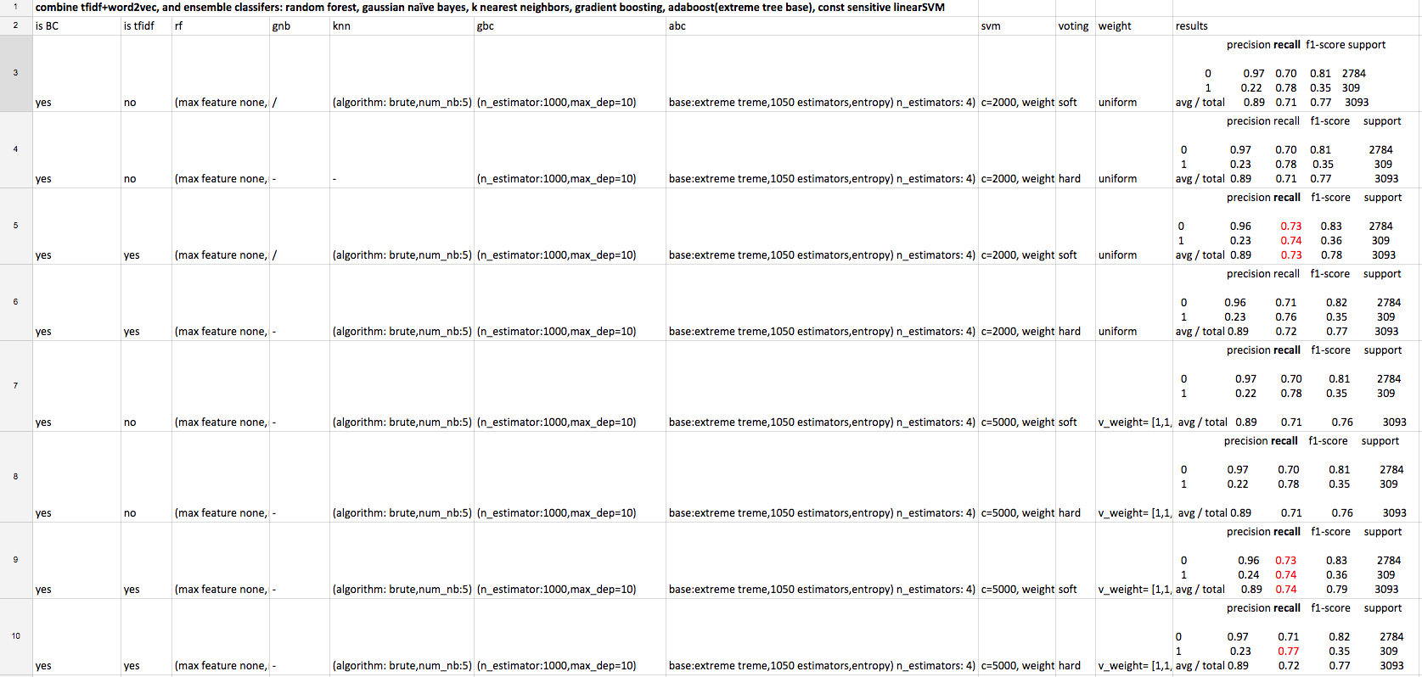
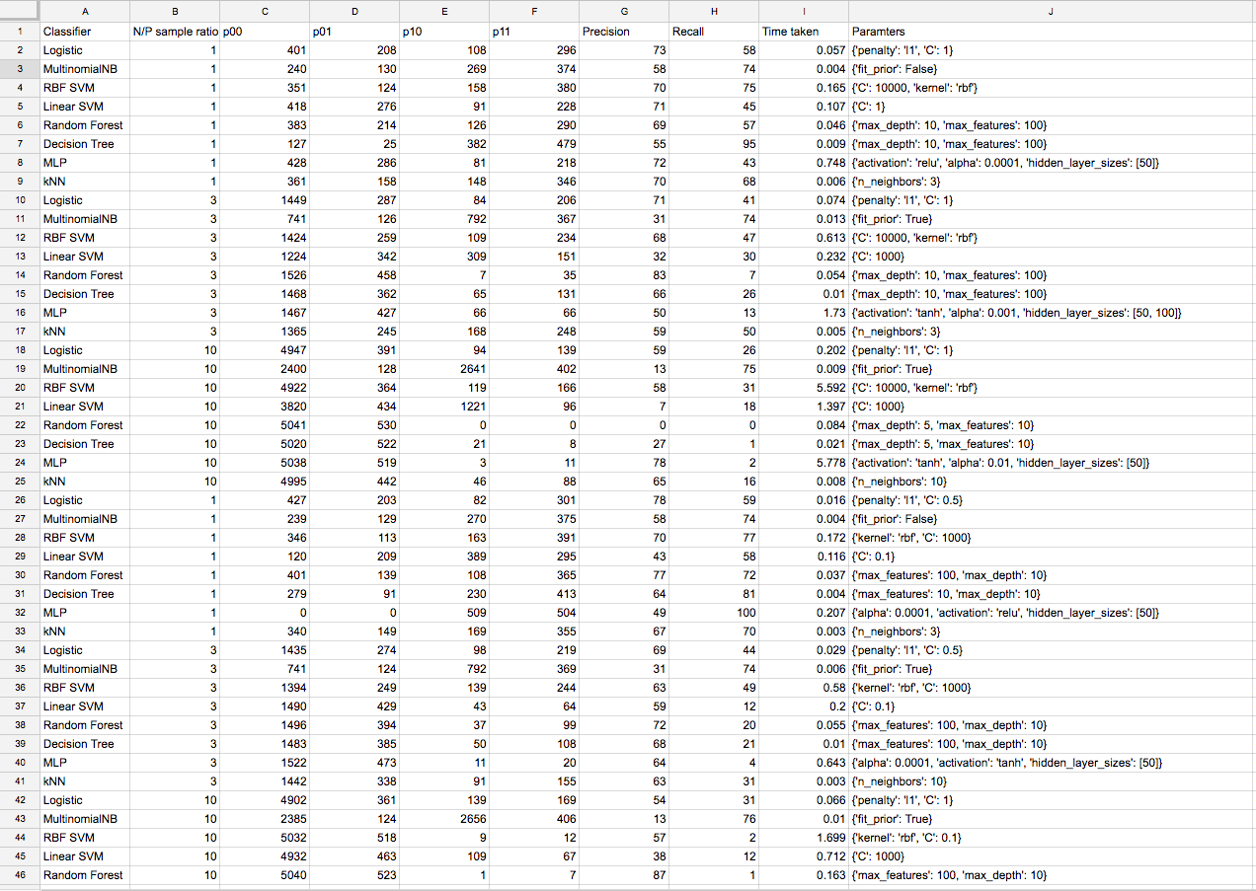
Tried from single classifier models + bag-of-words/word2vector + tfidf to voting ensemble….

Slide 21
One of the best initial models
Cost-sensitive SVM using linear kernel, penalty=7000, class_weight={0.050:5.6} without any data-centred approach:
 | Precision rate | Recall rate
non-Vulnerability | 96% | 72%
Vulnerability | 22% | 72%
Average | 88% | 72%
Still low positive precision rate !
Test result

Slide 22
Learning
1.1 Learning language embedding model
All Commits
Embedding
~3 million
1.2 Learning prediction model
2/3 Labeled Commits
Word2vec Model
Stacking ensemble
Identification Model
~7 thousand

Slide 23
Word embedding
Word embedding
Map words to vectors so that computers can understand
Word2vec
A word embedding method that uses a shallow 2-layer neural network to learn vector representation of words based on similarity in context
>>> word2vec['xss']
array([-0.06691808, 0.01889833, 0.08988539, 0.03727728, 0.09463213,
0.04498576, 0.02401953, 0.01821383, -0.04510168,...., -0.00888534], dtype=float32)
>>> word2vec.most_similar('xss')
[(u'vulnerability', 0.6009132862091064), (u'attacks', 0.5554373860359192), (u'forgery', 0.4951219856739044), (u'spoofing', 0.49092593789100647), (u'dos', 0.4852156937122345), (u'prevention', 0.48259809613227844), (u'clickjacking', 0.48095956444740295), (u'protection', 0.46756529808044434), (u'csrf', 0.457594096660614), (u'vuln', 0.4533842206001282)]

Slide 24
k-fold stacking
Feed to train 6 basic classifiers
Output 6 sets of test results
Each classifier k folds of test results
Random Forest
RF
RF
Split training data into k fold
Each fold split train and test set
Feed to optimize ensemble of basic classifiers
Gaussian Naïve Bayes
GNB
GNB
train set
K-nearest neighbors
KNN
KNN
test set
Logistic regression
…
K
2
SVM
SVM
1
SVM
Gradient Boosting
GB
GB
Adaboost
Ada
Ada

Slide 25
Testing
1/3 Labeled Commits
Word2vec Model
Identification Model
~3 thousand
Prob. of being Vulnerability
2. Testing Identification model
? > threshold Prob.
Vul or nonvul
Comparing with ground truth

Slide 26
Production observation
2 months
10/Dec/2016 – 15/Feb/2017
Observation
Tracked projects: 2070 → 5002
Triaged commits: 2512 (202 vuls, 2046 nonvuls)
Performance of the latest model
Threshold Probability | True Positive rate | True negative rate | Positive Precision rate
0.80 | 51% | 94% | 50%

Slide 27
Interesting questions
Identify more deeply hidden vulnerabilities
More features
Program Languages
Code changes, e.g, # of deletions, additions, changed files and directories
Automatic learning semantic features from programs’ Abstract Syntax Trees (ASTs)
Patch recommendation
Recommend developers patches or code snippets to fix the similar vulnerabilities

Slide 28
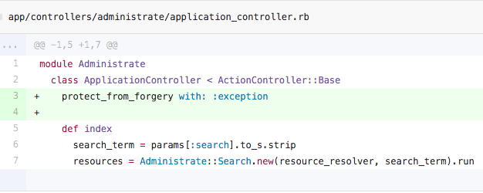
Shoppe
Spina
fat_free_crm
rails_admin
typus
CSRF patch for Administrate
Libraries affected by similar CSRF vulnerabilities

Slide 29
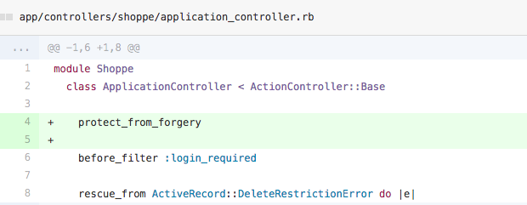
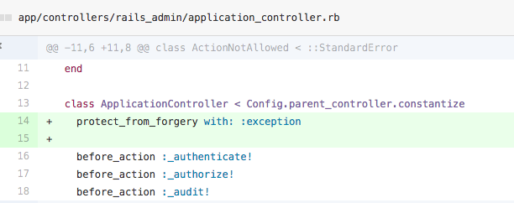
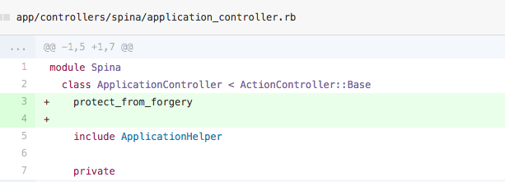
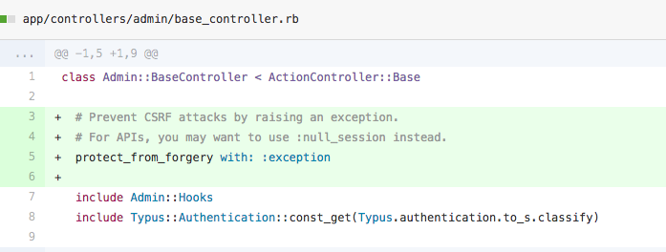
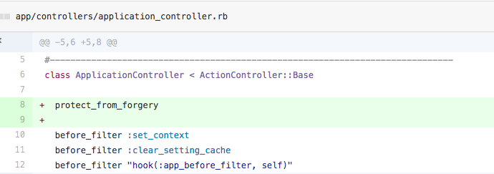

Slide 30
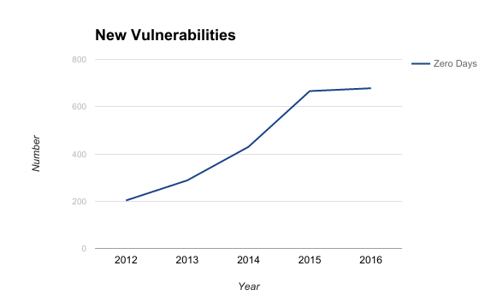
How do you find new vulnerabilities?
Source: Zero Day Initiative

Slide 31
Vulnerability discovery process
Manual review
Search for patterns through code
Grep
Static analysis
Post compilation
Fuzzing
Testing

Slide 32
Derived vulnerabilities
Exploitable usage of vulnerable library
Copy-paste vulnerable code
Similar issue in a different place

Slide 33
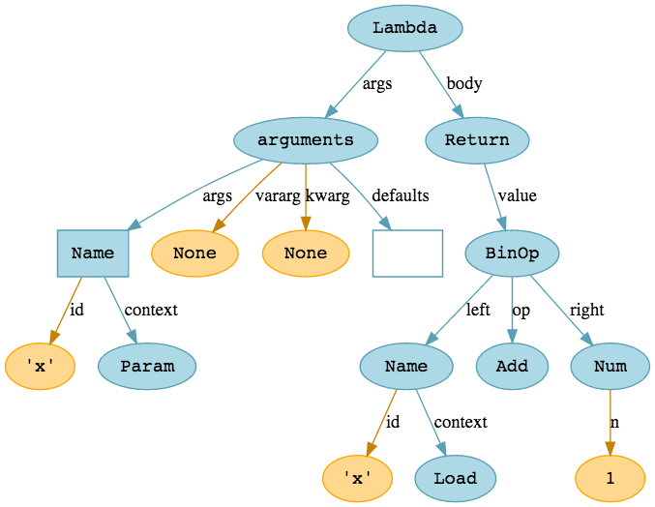
Tree structures occur frequently
Abstract syntax trees
Subclass hierarchies
Reference: http://hackflow.com/

Slide 34
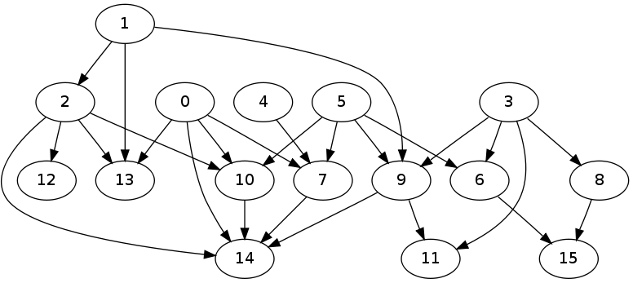
Graph structures occur frequently
Abstract syntax trees
Subclass hierarchies
Dependency graphs
Call graphs
Reference: http://stackoverflow.com/questions/12790337

Slide 35
Structured knowledge
Lots of effort poured into tracking open source libraries
Binary blobs in S3 aren’t useful
Lots more interesting analysis possible; how to make sense of data?

Slide 36
Knowledge graphs: Rails protect_from_forgery
Rails
has_class
ActionController::Base
language: ruby
version: 5.0.1
extends
extends
ApplicationController
depends_on
MyApp
has_class
MyController
calls
has_method
calls
protect_from_forgery
my_method

Slide 37
Knowledge graphs: Apache Commons Collections
Apache Commons Collections
has_class
ObjectInputStream
method
language: java
version: 3.2.1
depends_on
readObject
has_method
my_safe_method
MyApp
calls
has_method
calls
my_nice_method
my_method
calls
has_method

Slide 38
Building a knowledge base
Analysis is costly
Store graphs for offline processing
Relating data across domains
Composing complex queries
A library is calling some method AND has a vulnerable dependency
Notes:
How do we build such a thing? Here are the things we want and the criteria we have to meet

Slide 39
Graph databases
Index-free adjacency
No joins; first-class relationships
O(1) relationships, down from O(log n)
Matter with many recursive joins, i.e. traversal
Computation as traversal
Declarative
Supports ad hoc analysis
TinkerPop
Gremlin
Common algorithms

Slide 40
Describing vulnerabilities
Remote code execution through YAML.load
We want all libraries which call YAML.load in an unpatched Rails version
We want libraries:
For which there exists a call graph path from an entry point to to YAML.load
Depending on ActionPack < 2.3.15

Slide 41
Describing vulnerabilities
For which there exists a call graph path from an entry point to YAML.load
yamlLoad = g.V()
.has('type', 'library')
.has('identifier', 'ruby:stdlib:2.1')
.out('method')
.has('module', 'YAML')
.has('method_name', 'load')
.next().id()
hasPath = g.V(library)
.out('method')
.has('tag', 'entrypoint')
.repeat(out().simplePath())
.until(hasId(yamlLoad))
.path().limit(1).hasNext()

Slide 42
Describing vulnerabilities
Depending on ActionPack < 2.3.15
dependsOnActionpack = g.V(library)
.repeat(out('depends_on').simplePath())
.until(hasLabel('coordinates', 'actionpack')
.hasLabel('version', lt('2.3.15')))
.path().limit(1).hasNext()
vulnerable = hasPath && dependsOnActionpack
.as(...).select(...) will return fields from the query

Slide 43
YAML.load
ActionPack
has_module
YAML
language: ruby
version: 2.3.15
method
depends_on
load
has_method
my_safe_method
MyApp
calls
has_method
calls
my_nice_method
my_method
calls
has_method
Notes:
Queries would return all nodes connected by the red edges

Slide 44
Describing vulnerabilities
Rails CSRF due to forgetting protect_from_forgery in subclasses of ActionController::Base
We want libraries:
Depending on Rails
For which there does not exist a call graph path from some class c to ActionController::Base#protect_from_forgery
For which c is a subclass of ActionController::Base
Notes:
Another example, using information from new domains (subclass hierarchies)

Slide 45
Describing vulnerabilities
For which there does not exist a call graph path from some class c to ActionController::Base#protect_from_forgery
To express negation, find classes which call protect_from_forgery and use set difference
hasPath = g.V(library)
.out('class')
.repeat(out().simplePath())
.until(hasId(protectFromForgery))
.path().limit(1).hasNext()

Slide 46
protect_from_forgery
Rails
has_class
ActionController::Base
language: ruby
version: 5.0.1
extends
extends
ApplicationController
depends_on
MyApp
has_class
MyController
calls
has_method
calls
protect_from_forgery
my_method

Slide 47
Interesting questions
General graph queries
Similarity to program analysis techniques
Doop, LogicBlox, Soufflé, etc.
Richer domains ⇒ more interesting questions
What are all the libraries affected by this vulnerability?
How far do fixes propagate?

Slide 48
Perspectives
Good Engineering “creates” Good AI
Good AI + Good Human “beats” Great AI + No Human

Slide 50
Human involvement in AI development
Formulating interesting questions that can use AI
Generating the right data
Expert labeling and training
Evaluating the results and predictions

Slide 51
Thanks!
Questions?
Contact
Twitter: @asankhaya
Email: asankhaya@sourceclear.com

