Slide 1
Automating Continuous Planning in SAFe
Darius Foo, Jonah Dela Cruz, Subashree Sekar, Asankhaya Sharma
Veracode

Slide 2
Agile teams
Notes:
Originally designed for small, collocated teams
Used today in large organizations of 20,000+ people
78% of the time with multiple distributed teams

Slide 3
Notes:
Scaled Agile Framework (SAFe)
Most popular (35% of respondents in 14th State of Agile report)
(anything else?)

Slide 4
Notes:
Team level – you know
Program level – similar teams forming a train and working on objectives and dependencies together
5 sprints and 1 IP sprint
Portfolio level – management who decide where investment should go come up with priorities for the train (high level)
In Veracode, each product has its own train
PMs
Architects
Security team
They meet together and come up with the portfolio level work
Each team in their PI objective (what the ART commits to delivering in one PI) has the objectives added – Security, Architecture work and features
Explain about how security process fits in. How PI objectives contains Purina.

Slide 5
PI Planning
Meet face-to-face
Align goals
Cross-team dependencies
Match demand to capacity

Slide 6
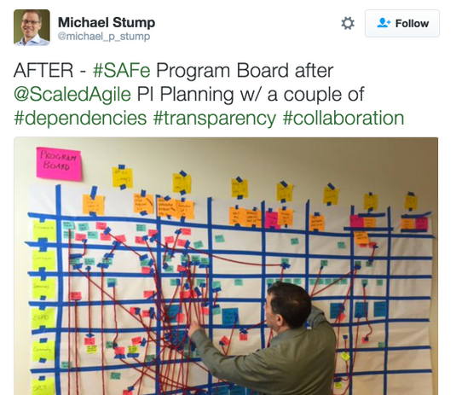
Limitations
Visibility across geos
Cross-geo dependencies
Manual digitization

Slide 7
Continuous Planning
Similar in spirit to CI/CD
Global visibility into a continuously-updated plan
Automate away overhead
Transparency and accessibility

Slide 8
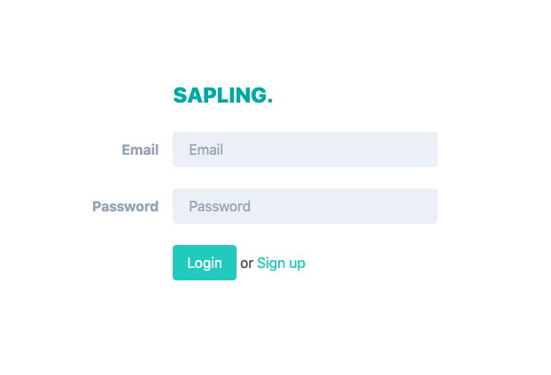
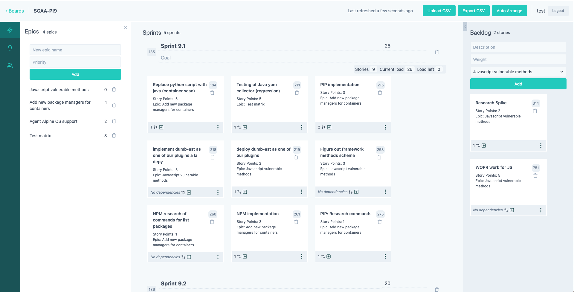
Sapling
A tool for Continuous Planning
Special support for SAFe PI Planning

Slide 9
PI Planning workflow
Teams begin with a prioritized list of epics
Time is divided into sprints
Epics are divided into user stories and assigned to sprints
Stories are assigned story points
Sprint capacities should be respected

Slide 10
Story dependencies
Within teams
e.g. “Research” item should always precede an “Implementation” item
Across teams
e.g. platform team should finish API before frontend team uses it
Requires communication
PI Planning is all about surfacing and negotiating cross-team dependencies

Slide 11
Enabling Continuous Planning
Sapling supports the workflow, allowing users to edit stories, sprints, epics, and boards
Stories are assigned to sprints automatically, so the plan is always up to date
Teams can request to add stories to each other’s boards
Dependencies across the entire organization are always visible
JIRA export

Slide 12
Story Assignments
Hard constraints:
Sprint capacity
Dependencies
Soft constraints (optimization)
Epic priority: minimize stories in lower-priority epics before higher ones
Context: minimize distance between dependent stories
Parallelism: maximize number of people working at the same time
Conservativeness: maximize earlier sprint assignments over later ones

Slide 13
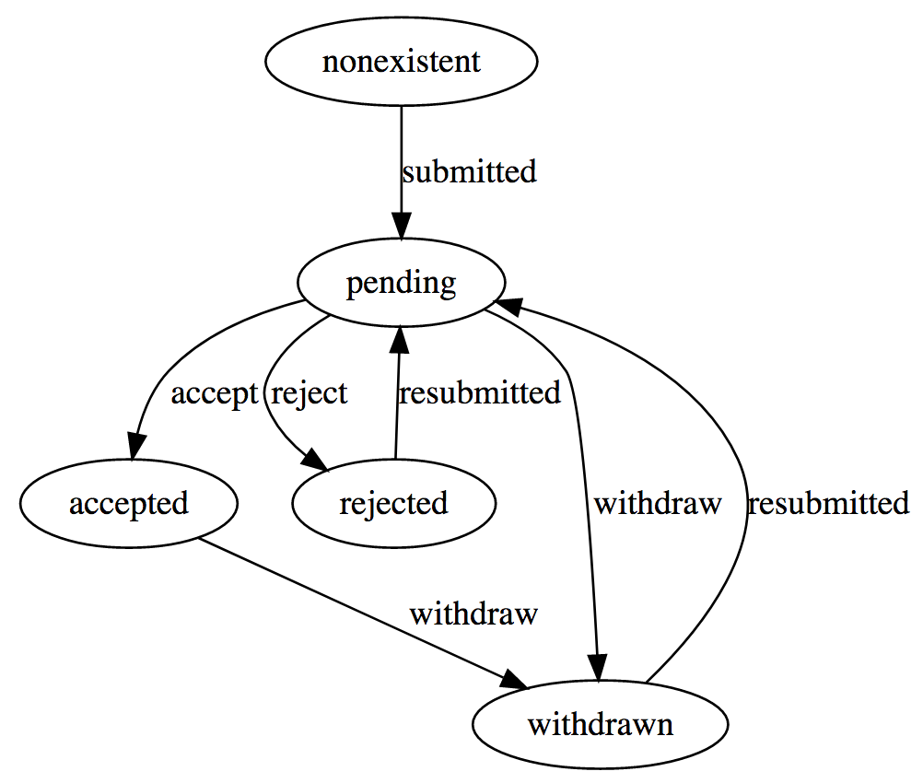
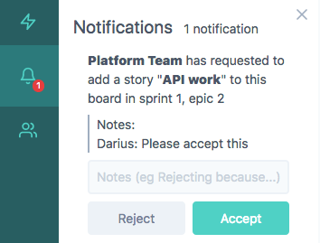
Story Requests
Structures the process of negotiating dependencies

Slide 14
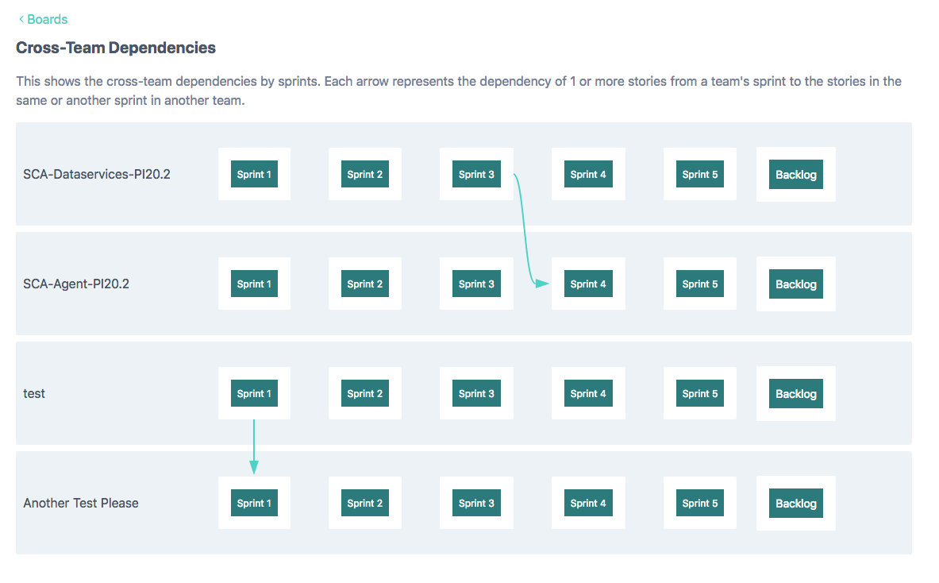
Story Requests
Visualization of cross-team dependencies

Slide 15
Demo

Slide 16
Future work
Explainability and UX of solver decisions
Previews
Incremental solving (allowing non-optimal solutions)
Deeper JIRA integration
https://github.com/srcclr/sapling

